Slide 1
Report on Titanic
Prepared by Shakil Ahammed

Slide 2
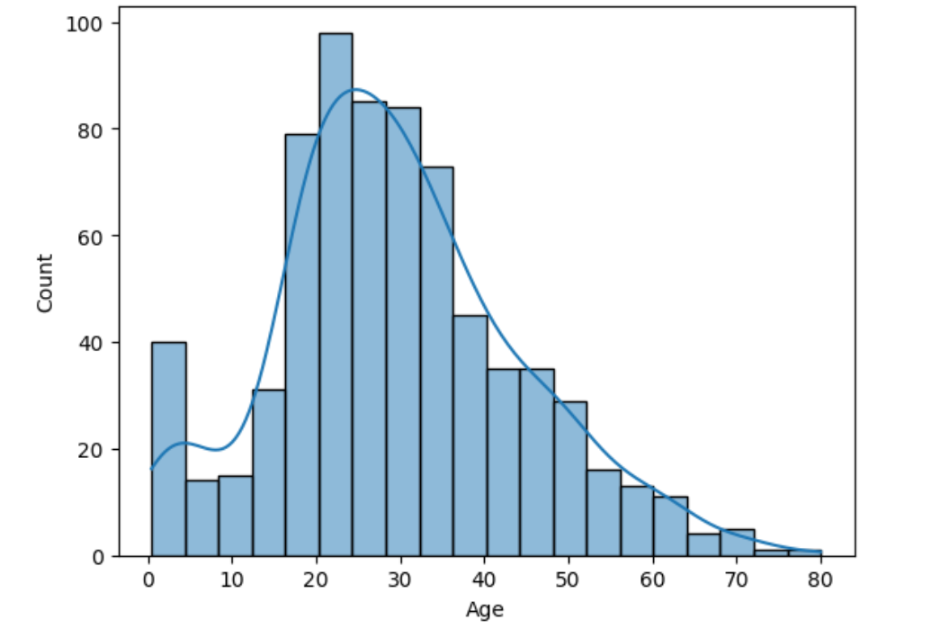
Insights
Most of the passenger’s age group is between 20-30 years.

Slide 3

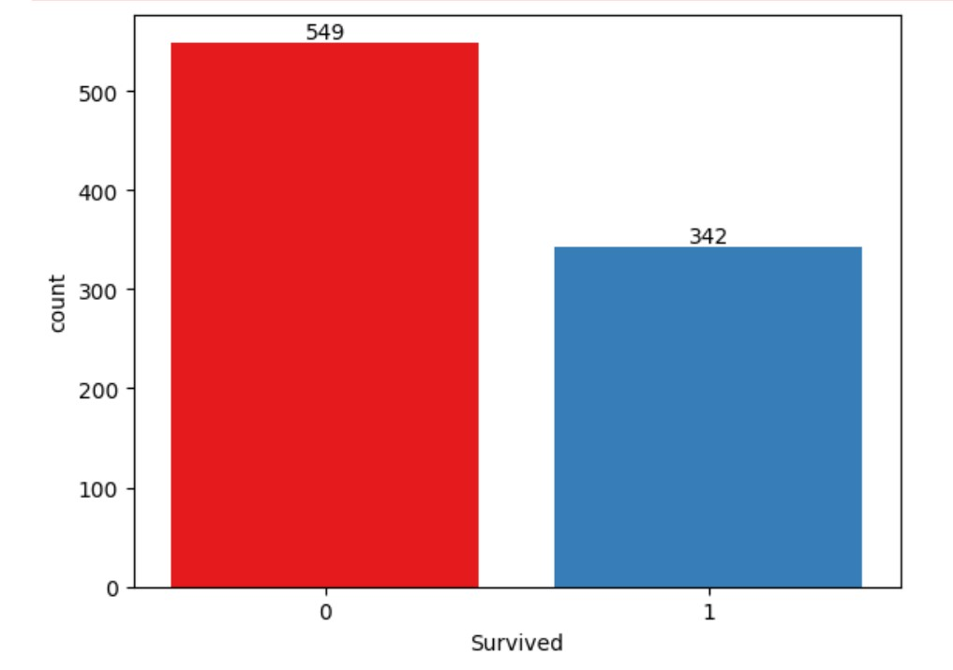
549 People was dead and 342 people survived.

Slide 4
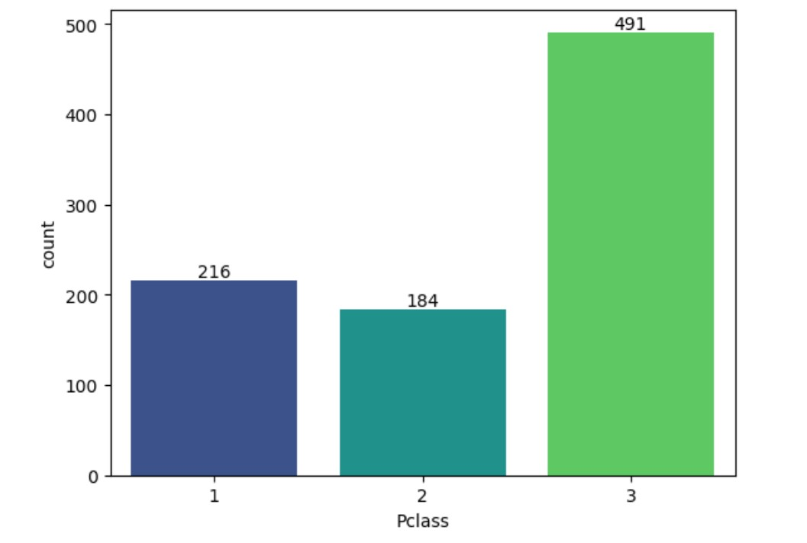
There were 216 passengers on 1st class, 184 passengers on 2nd class, and 491 passengers on 3rd class.

Slide 5
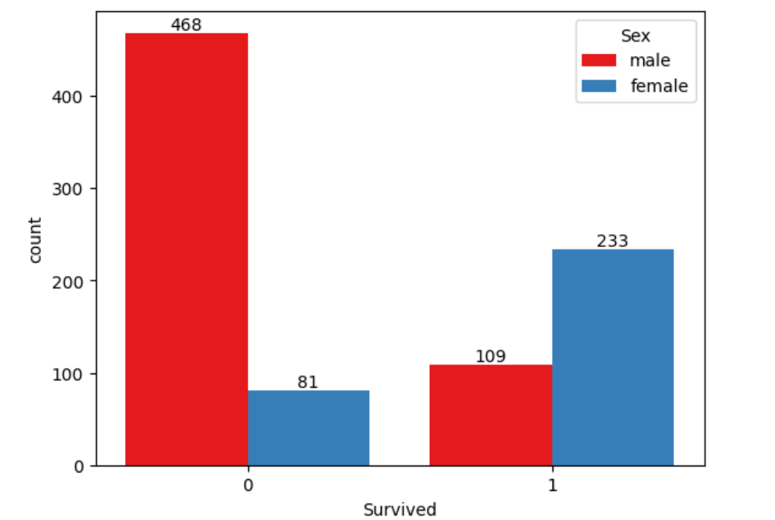
The female(233) has Better Chance of Survival than males.

Slide 6
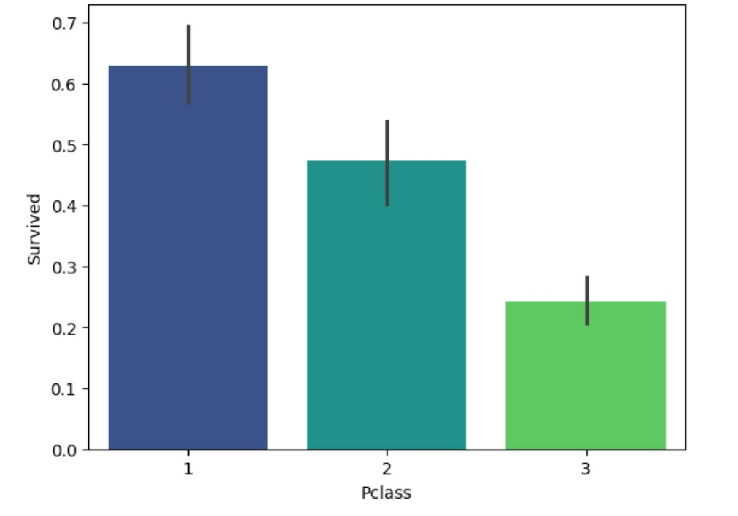
1st Class Has Better Chance of Survival.

Slide 7
Conclusion
Passengers who travel in 1st class their survival rate is higher.
Females survived more than males.

